Slide 1


Student Bridge
Prepared By:
Shrey Raj(16IT102)
Sachin Rathod(16IT105)
Guided By:
Asst. Professor
Jalpesh Vasa

Slide 2
Contents
Introduction
Problem & Solution
Features
Advantages
Future Work
References

Slide 3
Introduction
Student Bridge is android base application. Student Bridge use for schools that aims to simplify creating, distributing and grading assignments in a paperless way.
Student Bridges is made for those Users who are teachers & students. It is made with help of Android studio tool .
It is Android App which is installed in User’s Android Phone , Our application is communication application and it is used to provide remote access to systems and exchange files and messages in text formats between different User.

Slide 4
Problem Statement
Time Consumption for study material before exam
Lack of awareness of exam dates or notices
Social Media distraction
No central place for study material, resources and assignment

Slide 5
Solution
It act as an central place where you can post resources, assignments, and other class information.
Teacher can give assignment with deadline.
Student and Teacher can interact with other easily.

Slide 6
Features of Student Bridge
Provides study materials for each Department wise & semester wise so user can download and upload any documents.
Documents type : pdf , ppt ,word , png , jpg etc..
Provides department chartroom for teacher and student for both user. It is a best features of Student Bridge .

Slide 7
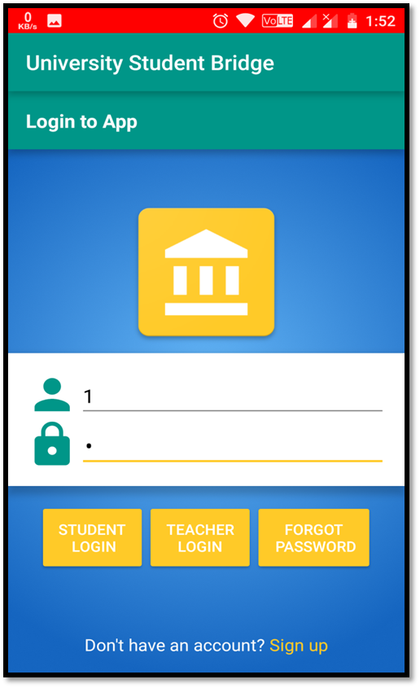
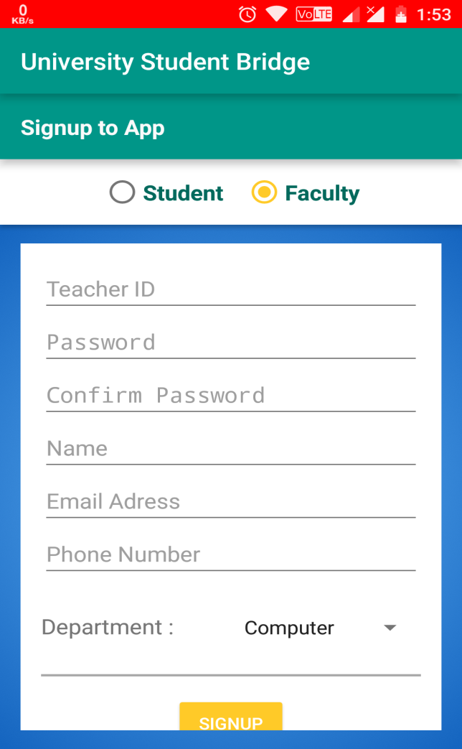
This is a login page & signup page of studentBridge application.
User sign up account as a teacher & student and than simple to login.
User have a some user name & password with help of this user can login in studentBridges application.

Slide 8
Advantages
It creates one central place where you can post resources, assignments, and other class information.
2. Feedback on announcements and assignments - student can comment on your posts and help each other understand if an assignment doesn’t make sense.
3. You can have discussions in context of a topic without separate accounts for clunky message boards.

Slide 9
Future Work
1. Directly download file and store in online drive(Google drive).
Can access file or chat from computer.
Making support for almost all android devices and video lecture support.
4. Directly access YouTube channel from app.

Slide 10
REFERENCES
1. https://developer.android.com/support
2. www.android.com
3. http://developer.android.com/reference/packages.html
4. www.youtube.com
5. http://developer.android.com/guide/topics/ui/declaring-layout.html
6. Android Design Patterns: Interaction Design Solutions for Developers (By: Greg Nudelman )

Slide 11
Thank
You

